Slide 1


Strategies for Scripting and Automating
Nick Giner
John Yaist
2022 ESRI DEVELOPER SUMMIT
Notes:
2022 Esri Developer Summit

Slide 2

Agenda
Overview of Python in the ArcGIS Platform
Why Python?
History of Python in ArcGIS
Demos
Resources

Slide 3

Why Python?
Why is it in ArcGIS
Why should I bother?

Slide 4
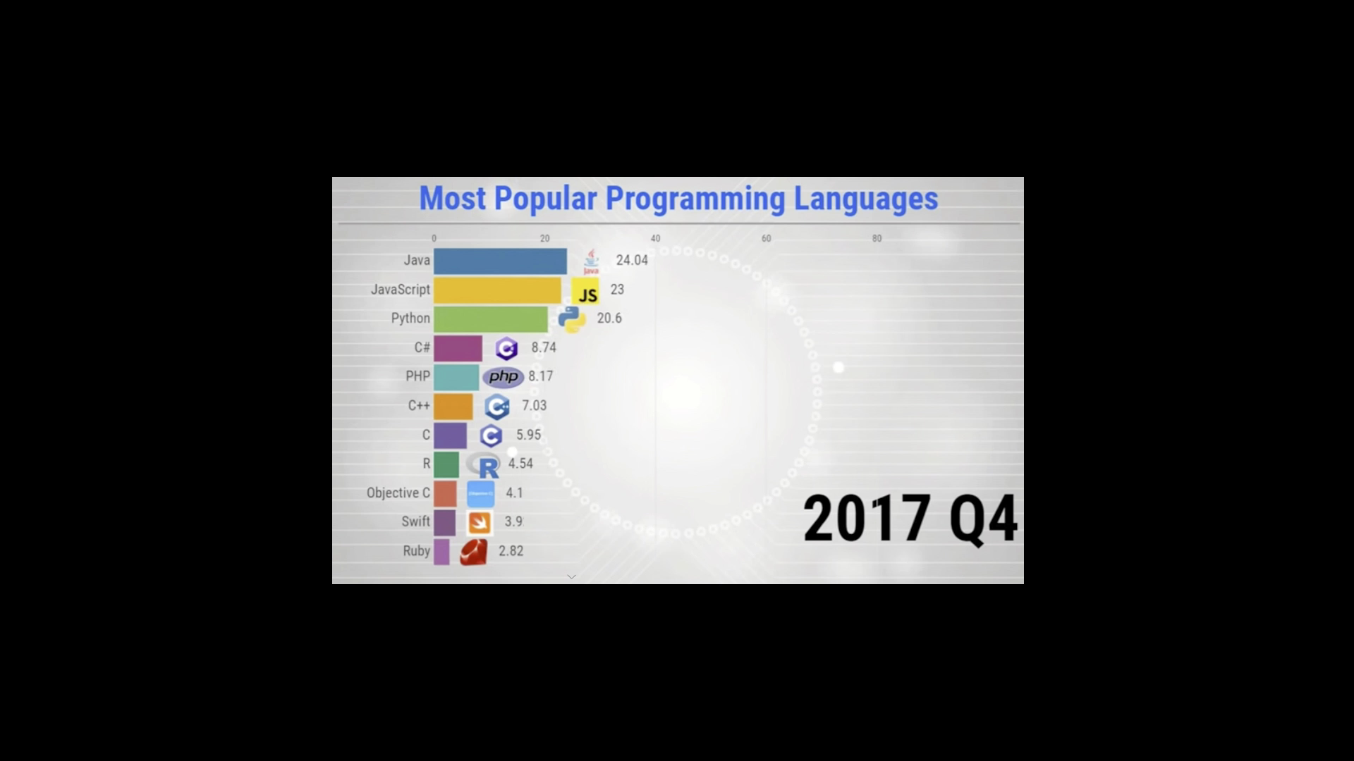
The most popular programming language
https://statisticsanddata.org/data/the-most-popular-programming-languages-1965-2021/
https://towardsdatascience.com/top-10-in-demand-programming-languages-to-learn-in-2020-4462eb7d8d3e
Notes:
* Recent explosive growth
* Ease of package management – solving dependency issues
* Non-experts increase domain productivity
No matter the computing environment
No matter the skill level
Consistency of interfaces
You know what you’re going to get
Knowledge transferrable outside domain expert –
Copy each other’s homework

Slide 5

Why Python?
We wanted to fit in, of course!!!!!!!!!!

Slide 6



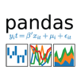

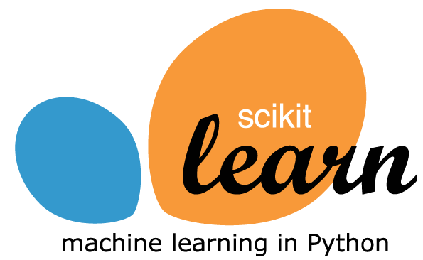



Why Python?
Scientific computing
Package management
Interface consistency
Platform agnostic
Domain experts could accomplish tasks
No matter the computing environment
No matter the skill level
Notes:
* Recent explosive growth
* Ease of package management – solving dependency issues
* Non-experts increase domain productivity
No matter the computing environment
No matter the skill level
Consistency of interfaces
You know what you’re going to get
Knowledge transferrable outside domain expert –
Copy each other’s homework

Slide 7






















ArcGIS Notebook
The Growth of Python in ArcGIS
Deep Learning Data Science Workstation
Foundational:ArcPy, Pro, REST API
Jupyter Notebooks Environments in Pro
1,718
Geoprocessing tools per release year
Growth:Deep Learning, Python API, Conda, R
Python API for ArcGIS Conda
SciPy Stack
Python 3 in Pro Python raster functions
1,200
arcpy.da Background Geoprocessing
ArcPy
Python Window
1,022
926
855
760
2010
2012
2014
2016
2018
2020
Notes:
In 2021 –
Advanced spatial analysis and data science – continues “to innovate on all the key building blocks of spatial analysis and data science: data engineering, visualization and exploration, spatial analysis, machine learning and AI, big data analytics, modelling and scripting, and sharing and collaboration.”
Data Engineering experience in ArcGIS Pro is one such example, along with continued integration with open source data science tools
Enhancements to better support temporal analysis across its products.
Integrating GeoAI, ML, and deep learning –
Doubled the total number of deep learning models supported within ArcGIS via the ArcGIS API for Python
New interactive analysis tools to ArcGIS Pro
Released pre-trained GeoAI models that can accelerate AI projects.

Slide 8











Python Everywhere
Enterprise
API for Python
Hosted Notebooks
Insights
Raster Analytics
GeoAnalytics
Enterprise
Pro
ArcPy
Drone2Map
Business Analyst
Workflow Manager
Desktop
Local Server
Local Server
Local Server
.NET
Java Qt
Runtime
Azure GeoAIDSVM
AWS Lambda
3rd party systems

Slide 9
How do we deliver Python
Runtime – all that’s necessary to execute code properly
ArcGIS Pro
arcgispro3 environment – wraps up ArcPy and ArcGIS API for Python + 273 other libraries
ArcGIS Online (ArcGIS Notebooks in Online) Runtimes
Standard
Advanced - arcpy
ArcGIS Enterprise (Notebook Server) Runtimes
Standard
Advanced - arcpy

Slide 10



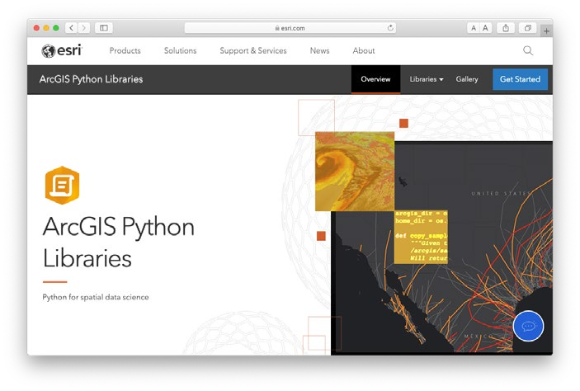



Section Header
ArcGIS Python Libraries: ArcPy and ArcGIS API for Python
ArcPy
ArcPy + ArcGIS API for Python
ArcGIS API for Python
Maps and projects
Deep access to Pro with simple code
1700+ geoprocessing tools
Manage web layers, maps, and tools
Deploy anywhere
Build geospatial deep learning models
Do everything with Python
Jupyter Notebook rich integration
Seamlessly blend web layers and local analysis
Section Subhead
Lightweight library for analyzing spatial data, managing your Web GIS, and performing spatial data science.
Comprehensive and powerful library for spatial analysis, data management, and conversion.
Pro
Enterprise
Online

Slide 11
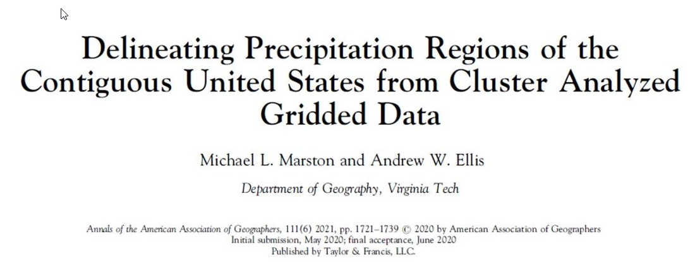
Demo: ArcGIS Pro Use Case
Nick Giner

Slide 12
Demo: ArcGIS API for Python
John Yaist
Administration
Content Management

Slide 13
Resources
Help and Samples
List of Python libraries in runtimes:
ArcGIS Pro – Work with Python packages
ArcGIS Enterprise and ArcGIS Online - ArcGIS Notebook Runtime Manifests
Code Samples:
ArcPy – ArcGIS Pro Python reference
ArcGIS API for Python – Sample Notebooks, Scripting with ArcGIS API for Python

Slide 14
Conclusion
Python integrates across the platform
The ArcGIS Python libraries are more accessible
Python provides the best of the open source world and GIS

Slide 15



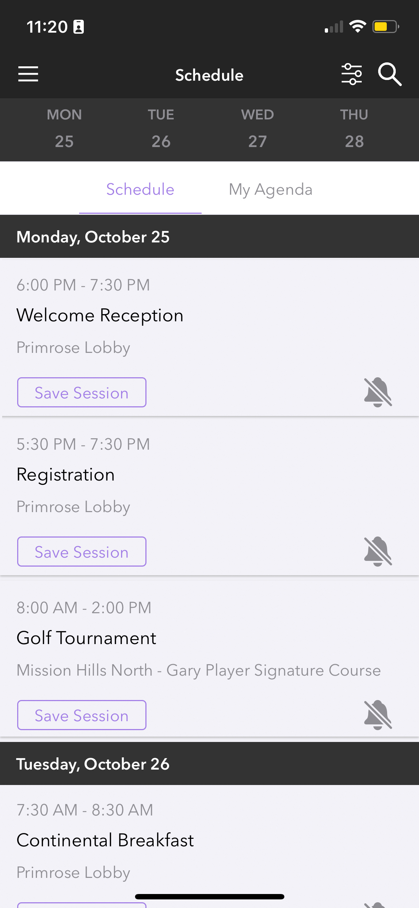
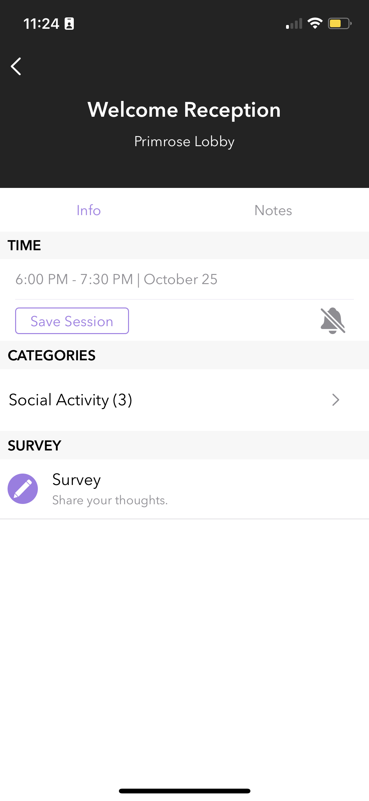
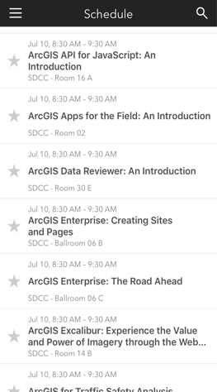
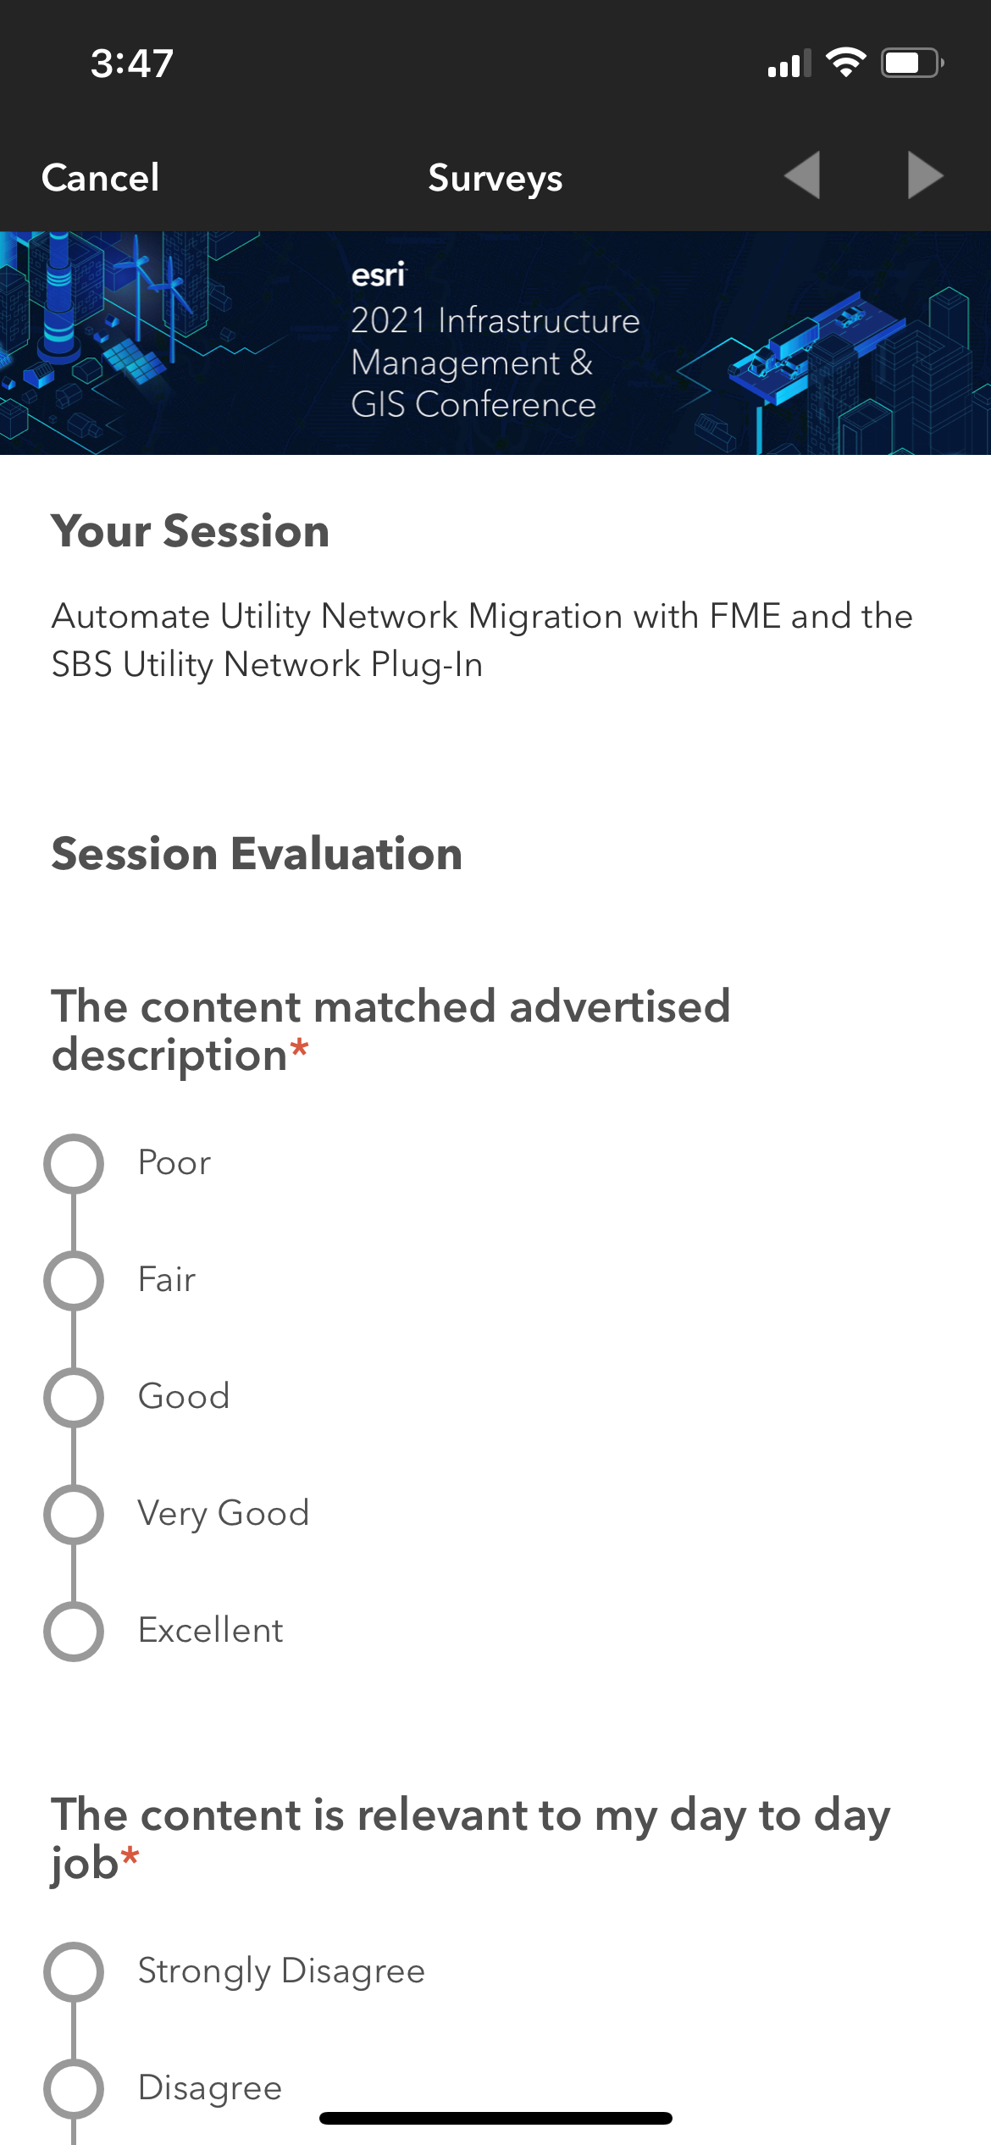
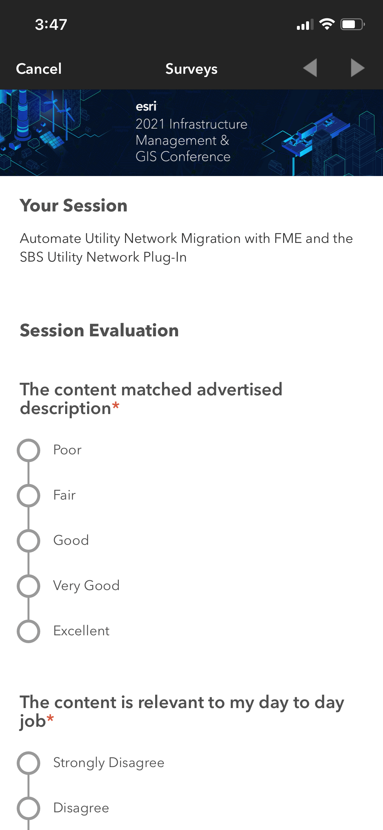
Please Share Your Feedback in the App
Download the Esri Events app and find your event
Select the session you attended
Scroll down to “Survey”
Log in to access the survey

Slide 16



Copyright © 2022 Esri. All rights reserved.

